Slide 1
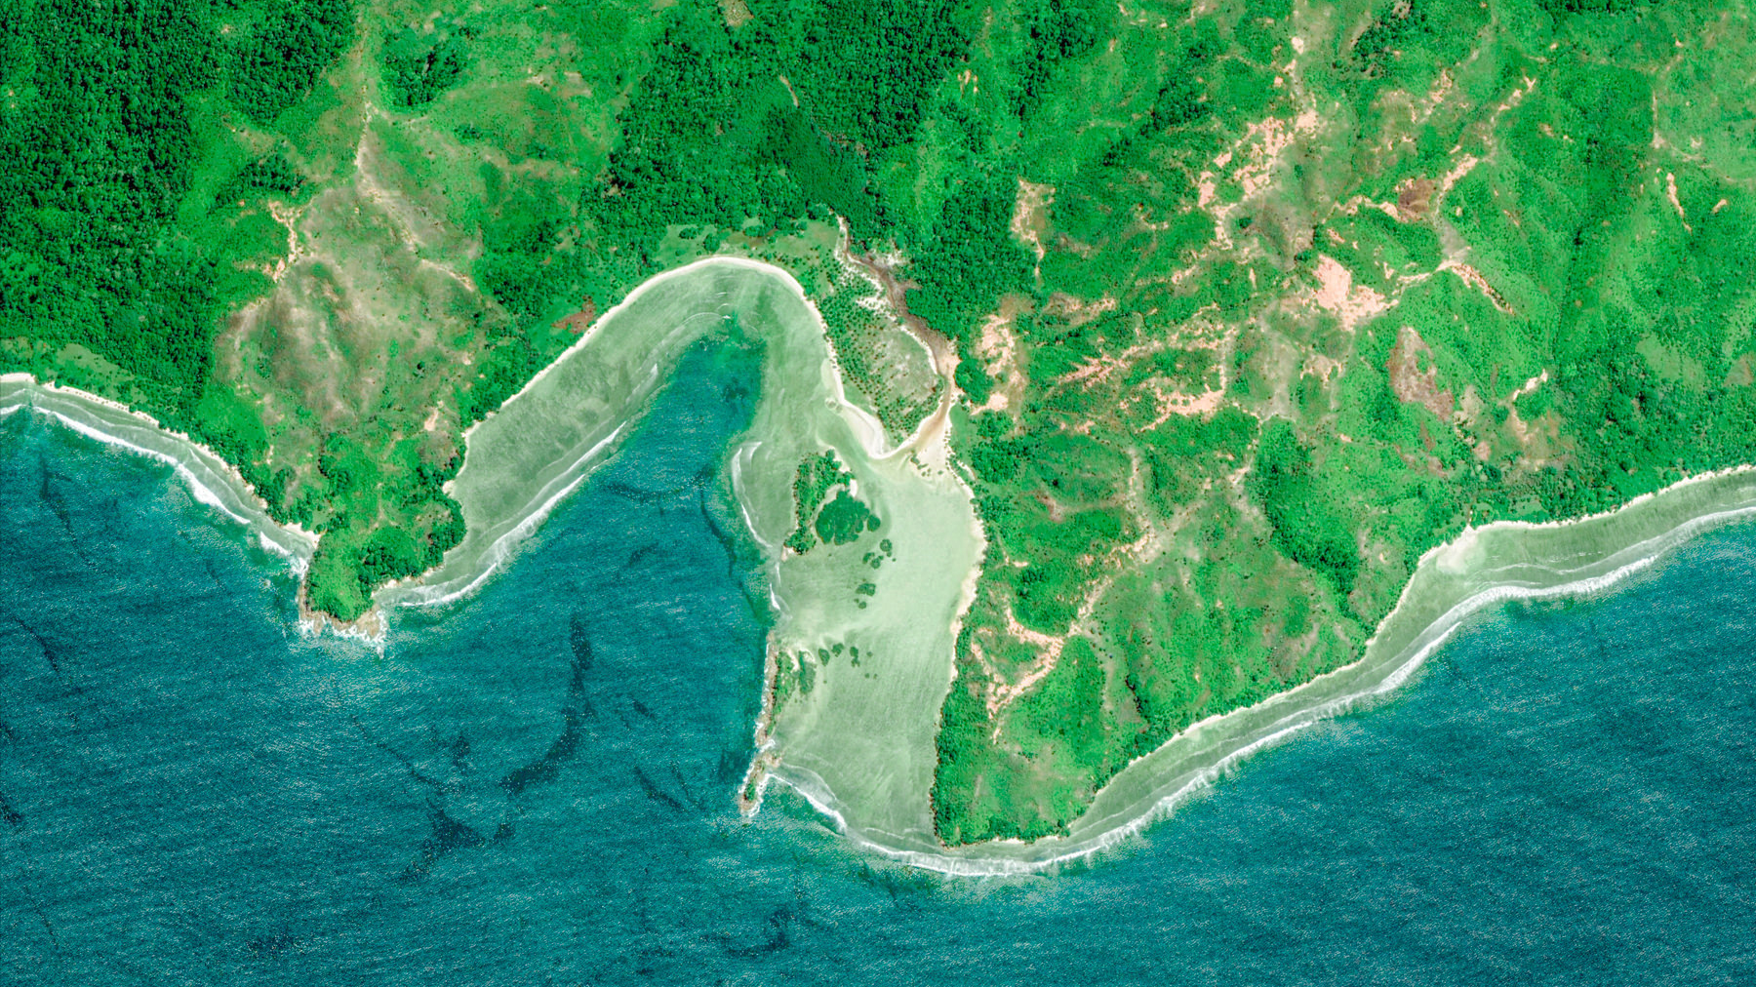


Atmospheric Intraseasonal Oscillations Leading to Sea Level Extremes in Coastal Indonesia during Recent Decades
Will Kamp¹, Weiqing Han¹, Lei Zhang¹, Shoichiro Kido², and Jay McCreary³
1 Department of Atmospheric and Oceanic Sciences, University of Colorado Boulder, Boulder, USA
2 Application Laboratory (APL), Research Institute for Value‐Added‐Information Generation (VAiG),
Japan Agency for Marine‐Earth Science and Technology (JAMSTEC), Yokohama, Japan
3 University of Hawaii at Manoa, Honolulu, USA
William.Kamp@colorado.edu
Acknowledgements:
NASA International Ocean Vector Wind Science Team award 80NSSC23K0982 NASA Ocean Surface Topography Science Team award 0NSSC21K1190

Slide 2
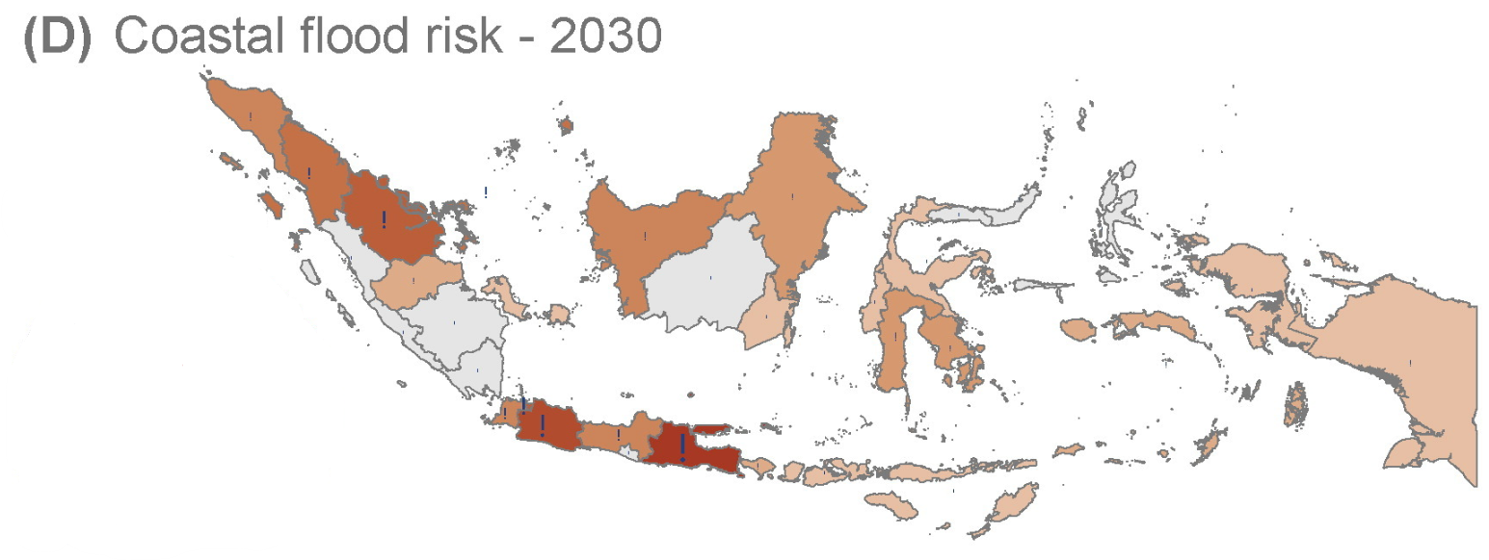
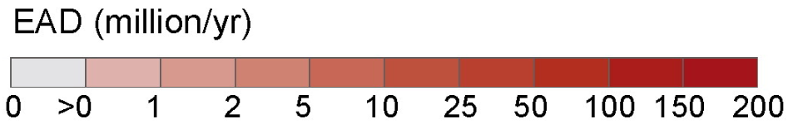
Background:
High EXtreme (HEX) sea level events have large impacts on coastal communities, especially island nations
HEX events will be more damaging in the future due to:
Anthropogenic sea level rise
Urban expansion in coastal areas
(Muis, 2015)

Slide 3
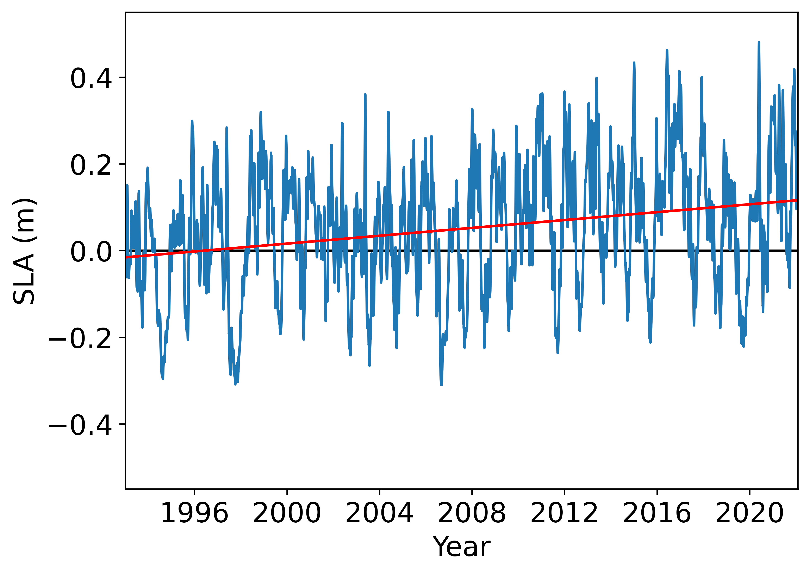
Background:
Java SLA internal variability exceeds the magnitude of anthropogenic sea level rise
Our goal is to understand the role of intraseasonal variability on HEX along the Java coast bordering the Indian Ocean
The satellite mean Java SLA (blue) and its linear trend (red) are shown from 1993-2021

Slide 4
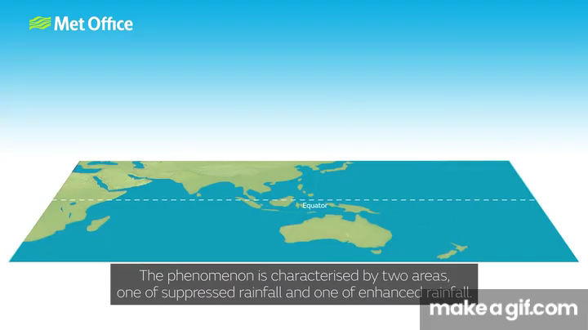
Madden-Julian Oscillation (MJO):
The MJO is the dominant mode of intraseasonal variability in the tropics
The MJO is associated with large scale convection and wind patterns over the Indian and Pacific Oceans

Slide 5
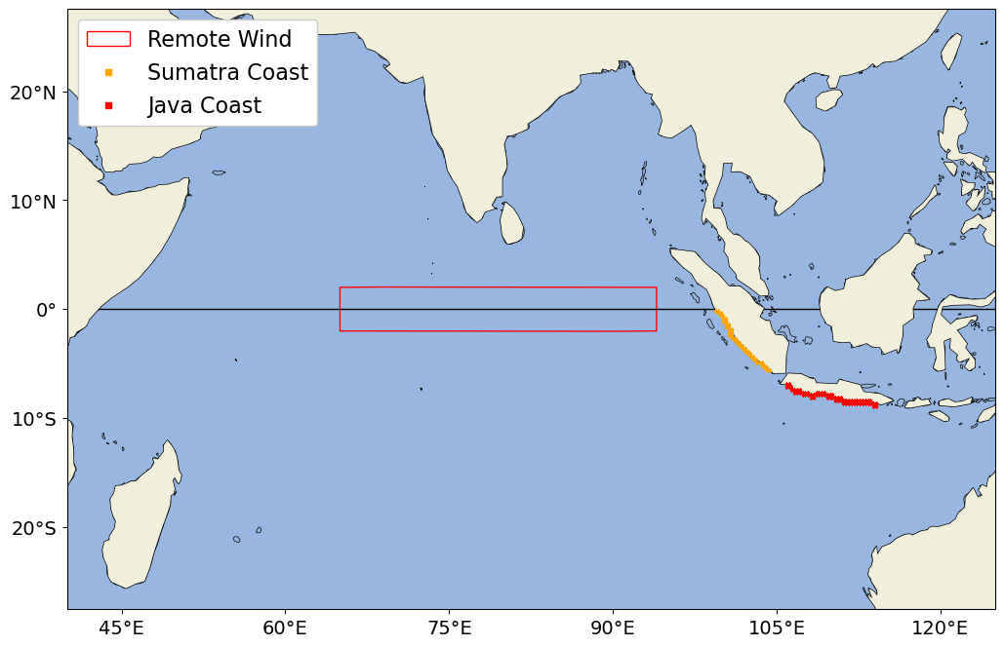
How can the MJO influence Java sea level?
Remote westerly winds create equatorial Kelvin waves
Local longshore winds create and enhance coastal Kelvin waves
Black arrows indicate winds consistent with increasing Java SLA and blue arrows indicate the associated Ekman transport

Slide 6
Research Questions:
1. How does the Madden-Julian Oscillation (MJO), drive HEX events along the coast of Java?
2. How does the seasonality of the MJO impact HEX events?
Black arrows indicate winds consistent with increasing Java SLA and blue arrows indicate the associated Ekman transport
6

Slide 7
Research Questions:
Approach:
1. How does the Madden-Julian Oscillation (MJO), drive HEX events along the coast of Java?
Quantify impact of surface wind stress vs buoyancy flux with the Regional Ocean Modelling System (ROMS)
2. How does the seasonality of the MJO impact HEX events?
7

Slide 8
Research Questions:
Approach:
1. How does the Madden-Julian Oscillation (MJO), drive HEX events along the coast of Java ?
Quantify impact of surface wind stress vs buoyancy flux with the Regional Ocean Modelling System (ROMS)
Determine role of equatorial wind and local longshore wind forcing on Java SLAs using
Bayesian dynamic linear model
Composite analysis
2. How does the seasonality of the MJO impact HEX events?
8

Slide 9
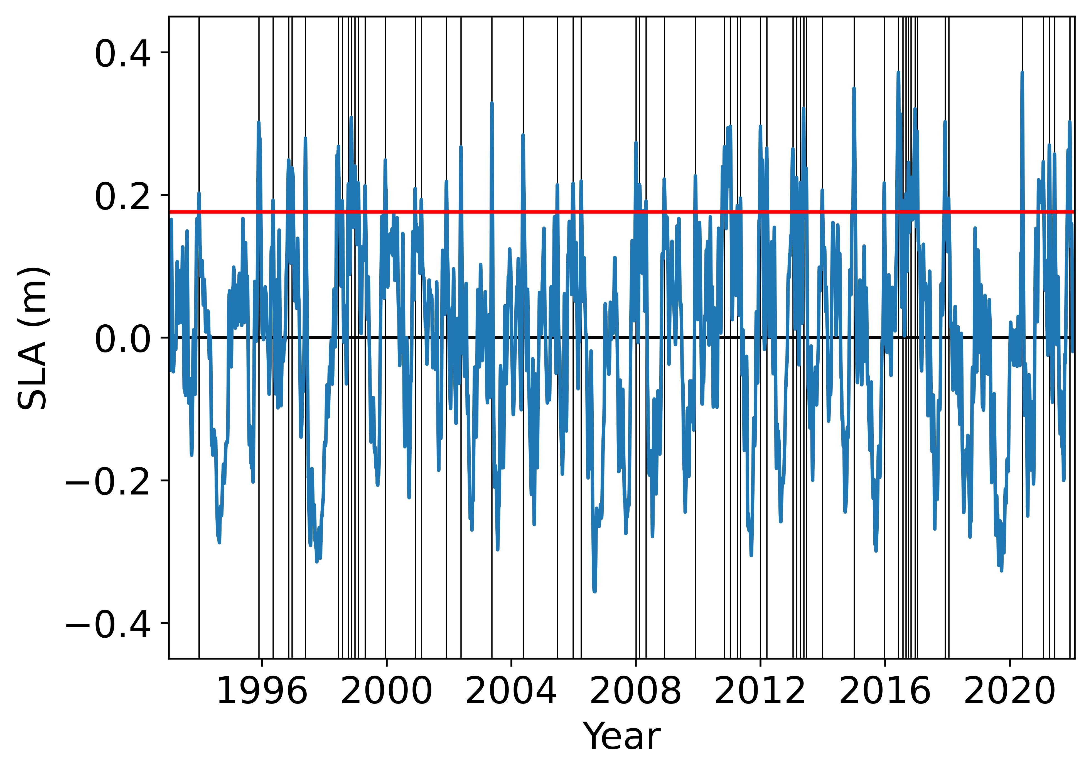
Definition of HEX events:
Java SLA observed using satellite data from 1993-2022
HEX events were defined as detrended satellite Java SLA that exceeds the 90th percentile for at least 5 consecutive days.
56 HEX events from 1993-2022
The satellite Java SLA (blue), its 90th percentile (red), and HEX (vertical black lines) are shown from 1993-2021
Notes:
Java SLA is observed using the Data Unification and Altimetry Combinations System or DUACS as satellite altimetry data along the southern coast of Java from 1993-2022. This satellite data was validated against 4 tide gauges along the Indonesian coasts
We found the mean along the southern coast of Java, shown in blue, and removed externally forced sea level rise by subtracting the linear trend. We defined HEX, shown as vertical black lines, as events that exceeded the 90th percentile, shown in red, for at least 5 consecutive days. We identified a total of 56 HEX events from 1993-2022

Slide 10
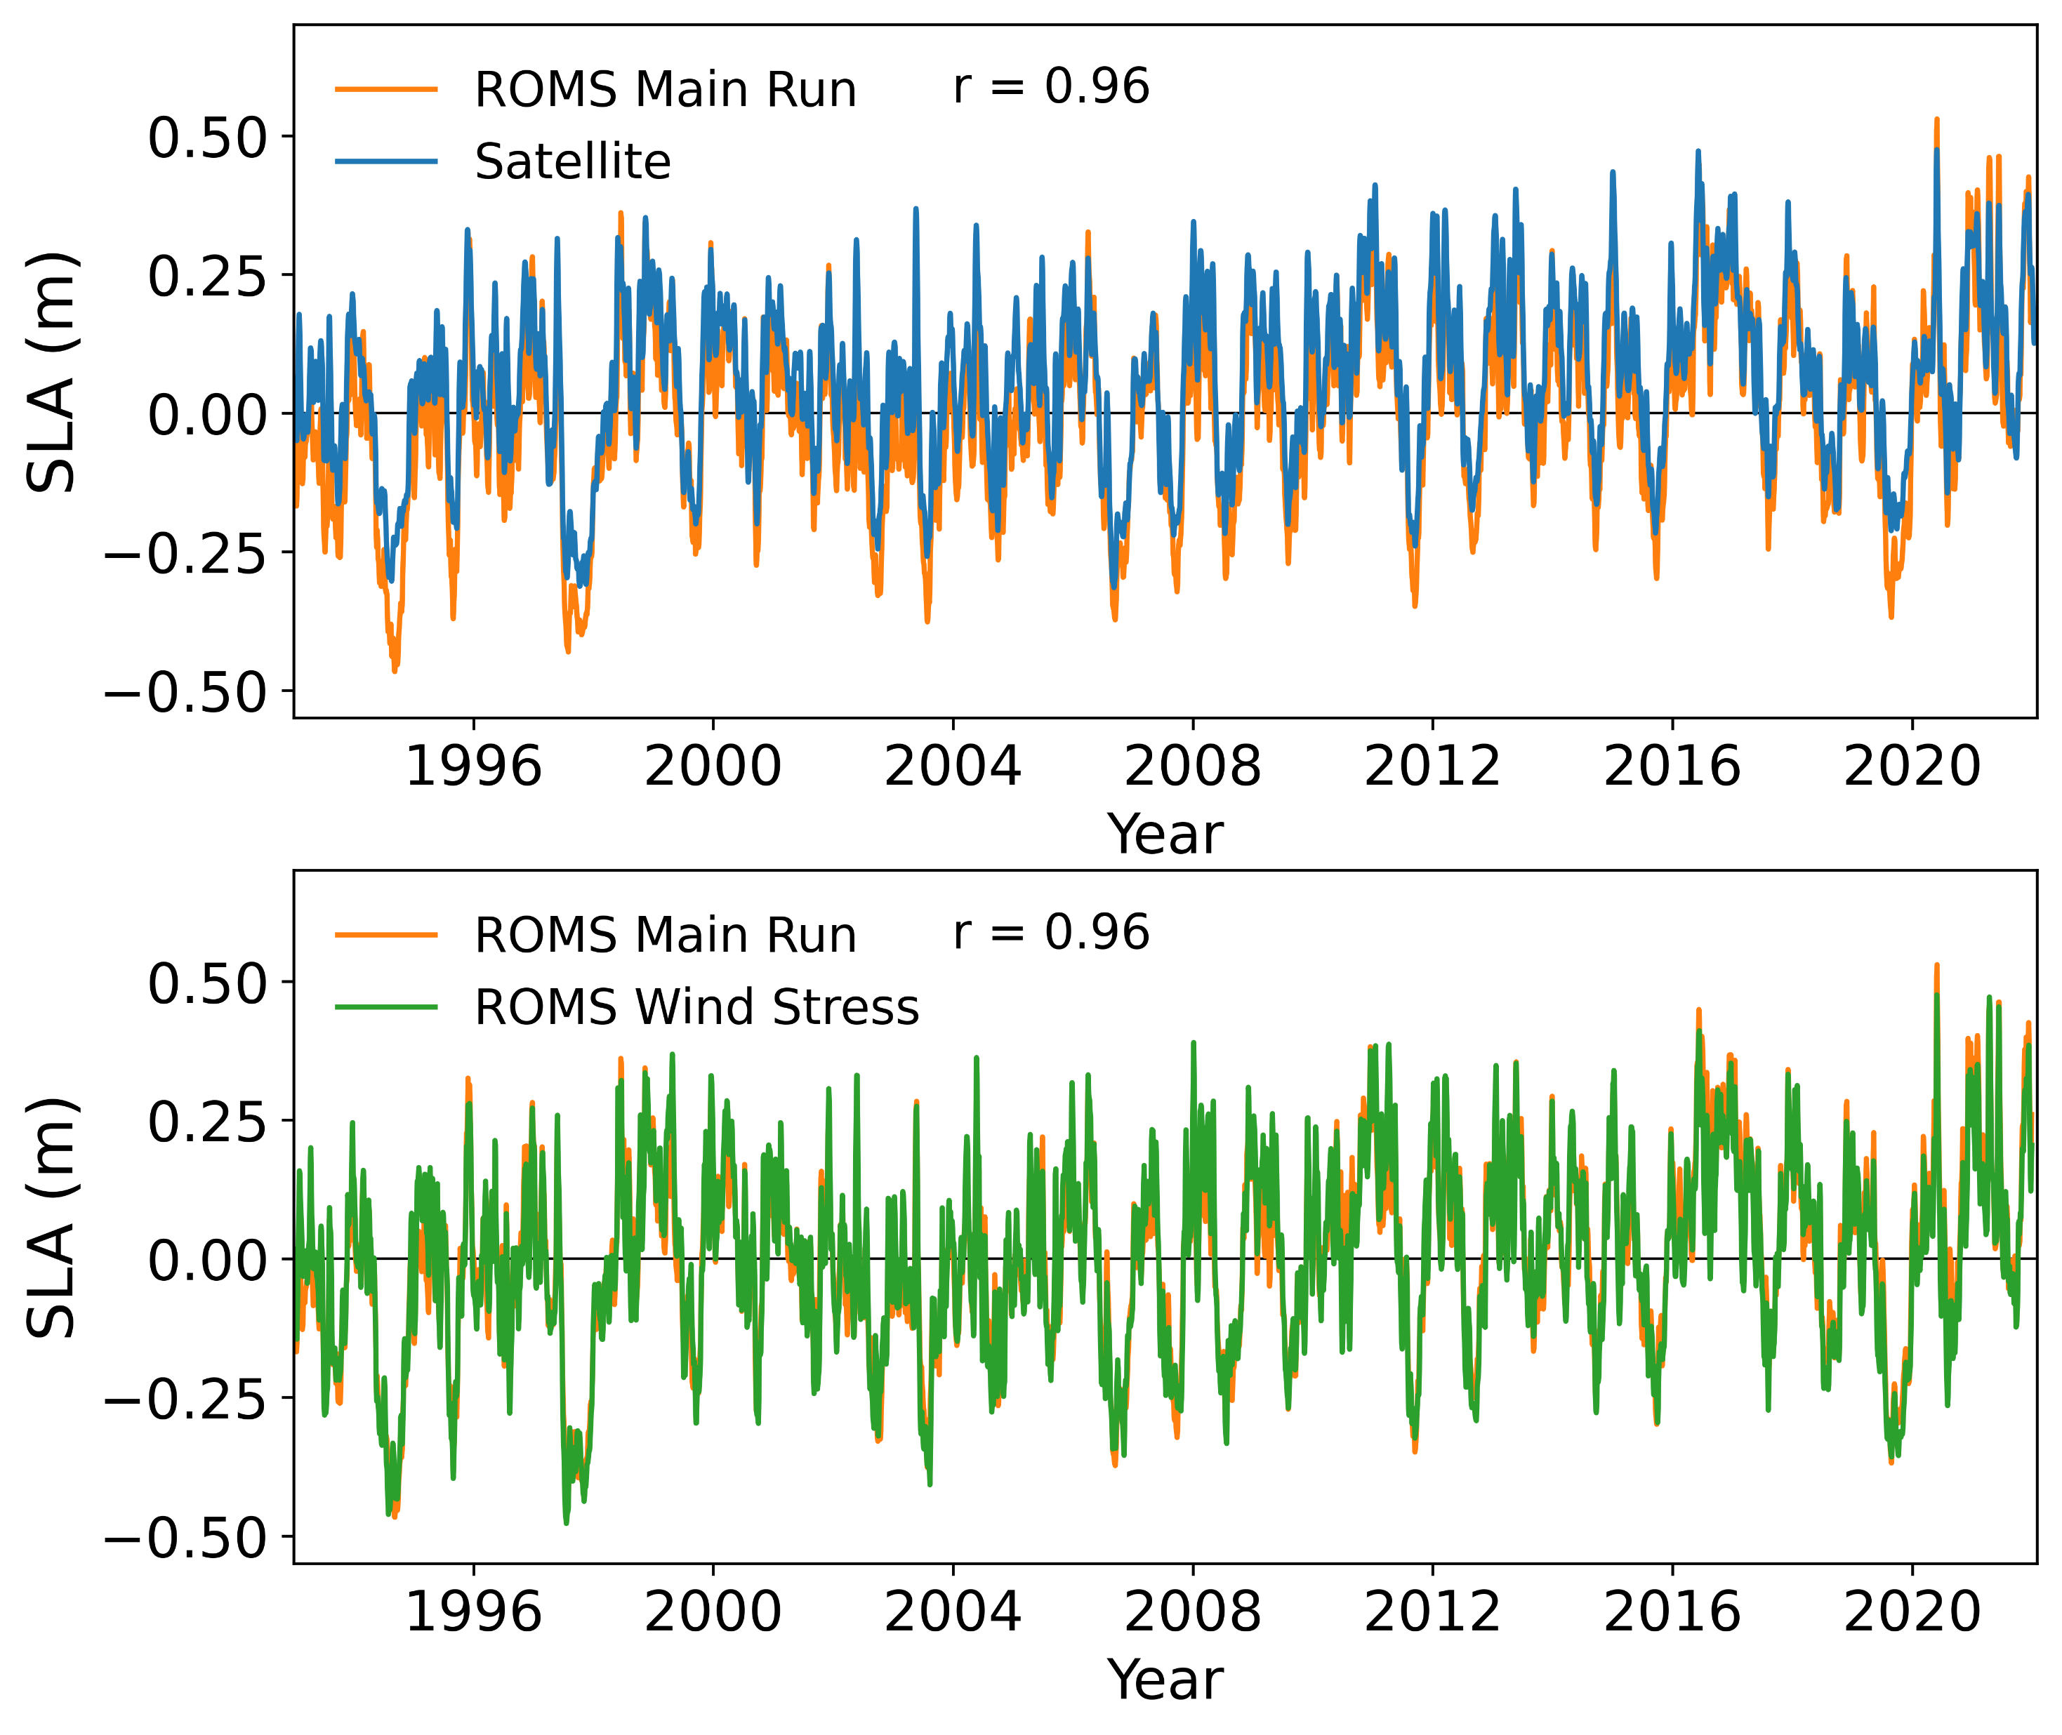
Wind stress vs. buoyancy flux
Regional Ocean Modelling System (ROMS) main run validated successfully using satellite observations
ROMS Wind Stress run shows wind stress is the dominant physical process controlling Java SLAs

Slide 11
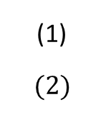
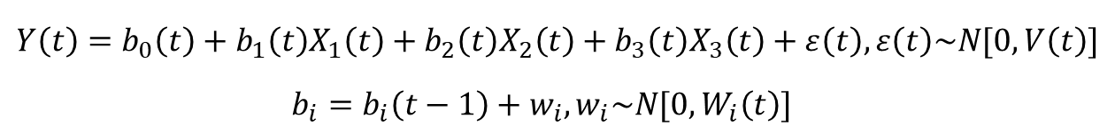
Bayesian Dynamic Linear Model:
$Y\left(t\right)=b_{0}\left(t\right)+b_{1}\left(t\right)X_{1}\left(t\right)+b_{2}\left(t\right)X_{2}\left(t\right)+b_{3}\left(t\right)X_{3}\left(t\right)+ε\left(t\right), ε\left(t\right)\sim N[0,V\left(t\right)]$
$b_{i}=b_{i}\left(t−1\right)+w_{i}, w_{i}\sim N[0,W_{i}\left(t\right)]$
(1)
$$(2)$$
Quantified wind stress forcing on Java SLAs at intraseasonal timescales
Predictors:
zonal wind stress from equatorial Indian Ocean (remote wind)
longshore wind stress along Sumatra
longshore wind stress along Java

Slide 12
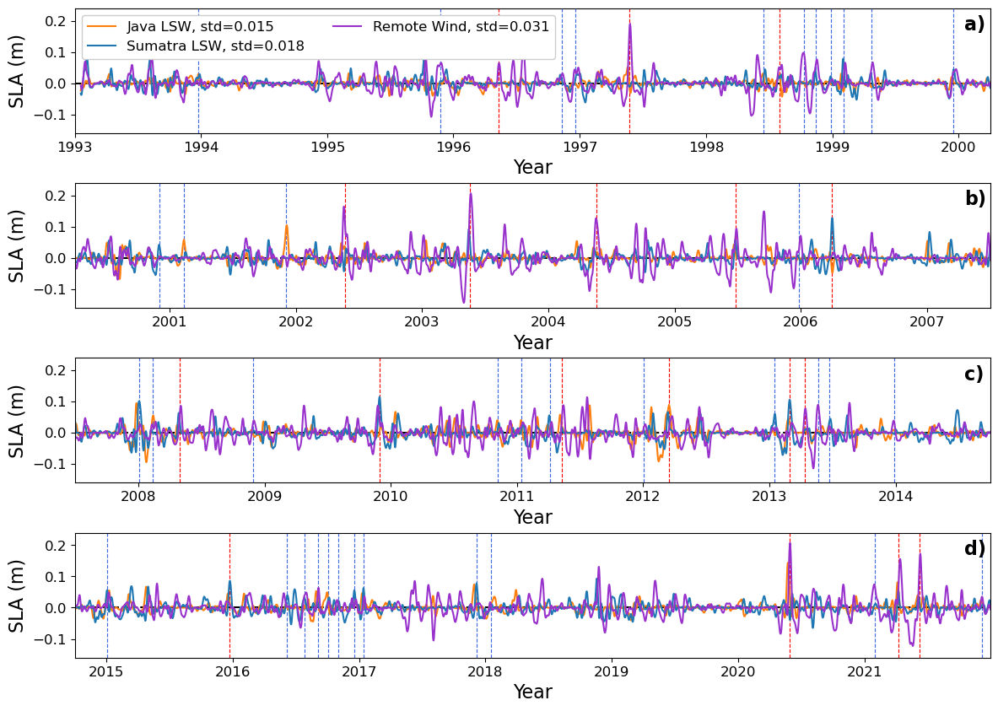
Bayesian Dynamic Linear Model Results:
Remote wind is most important for HEX events overall, but local longshore wind is important for some events
Remote wind forcing peaks during boreal spring

Slide 13
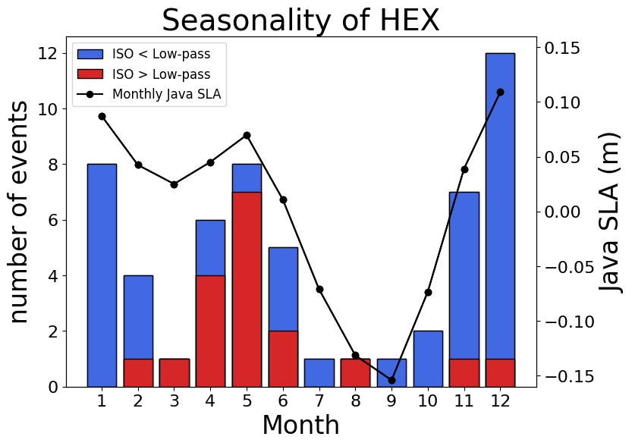
Seasonality of HEX events
HEX events have a strong seasonal cycle peaking during winter and spring
Intraseasonal SLAs are dominant during the spring peak

Slide 14
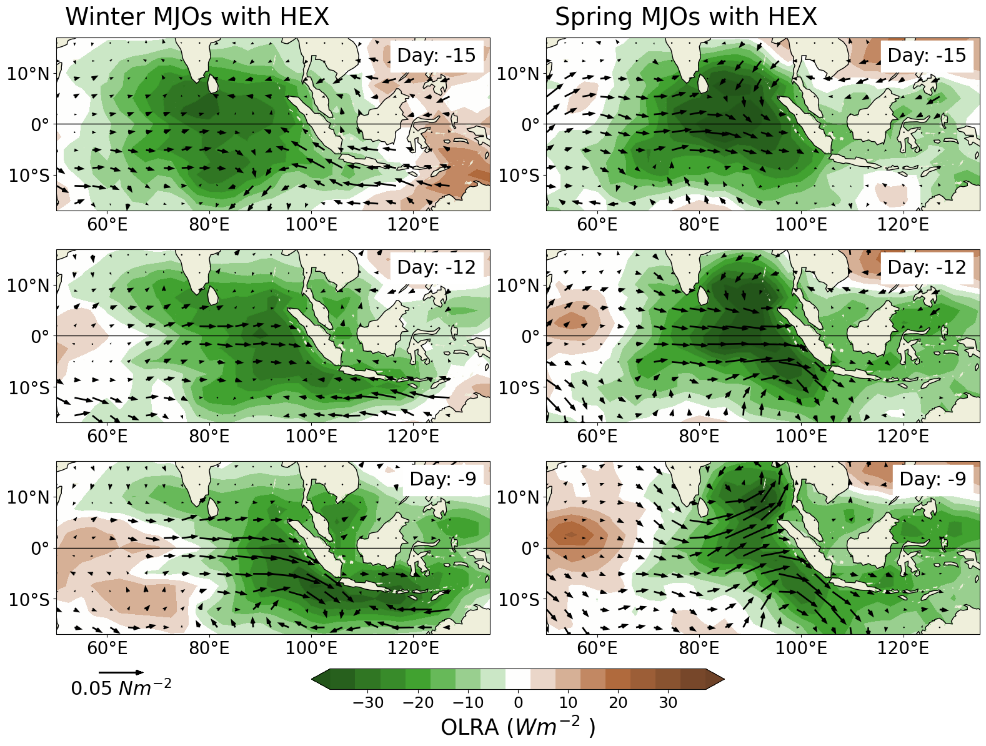
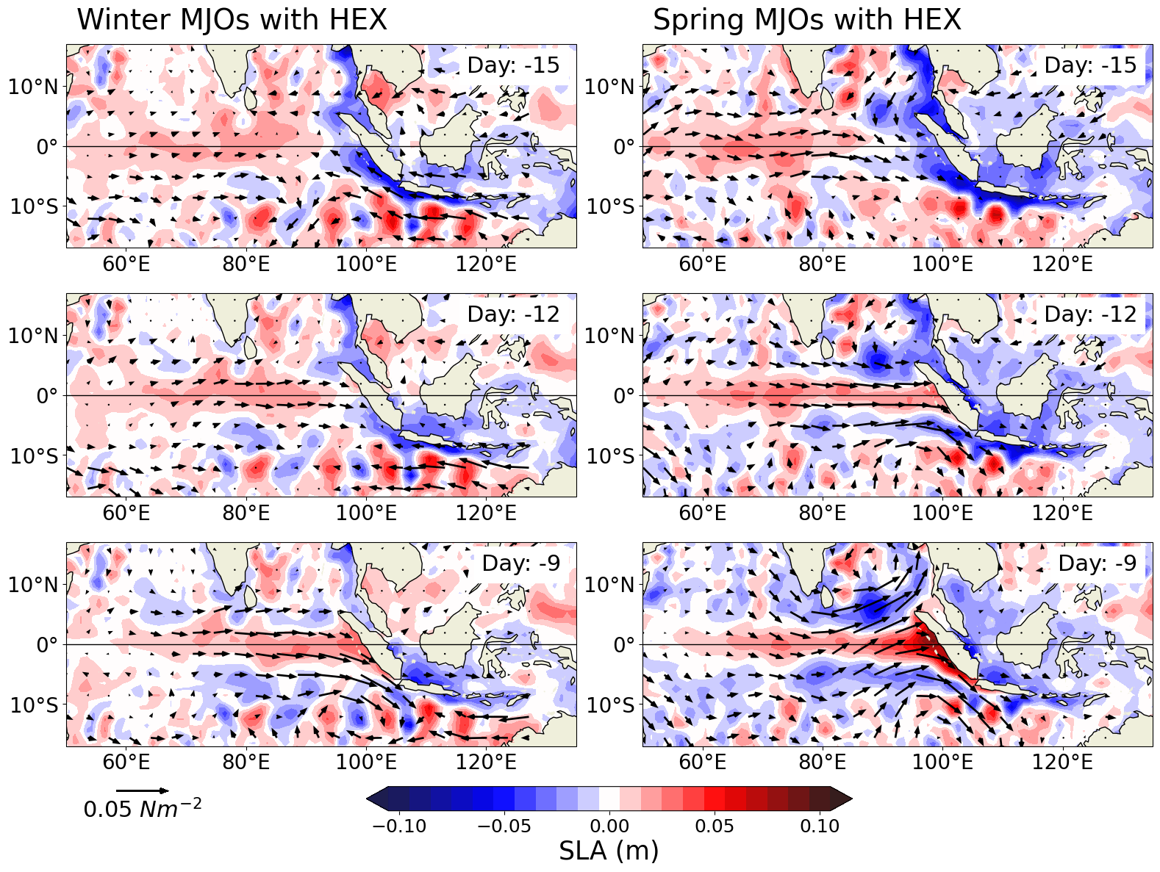
Seasonality of MJOs related to HEX
Spring MJOs have greater OLRA (convection) over the equatorial Indian Ocean
Spring MJOs produce greater westerly wind stress over the equatorial Indian Ocean

Slide 15
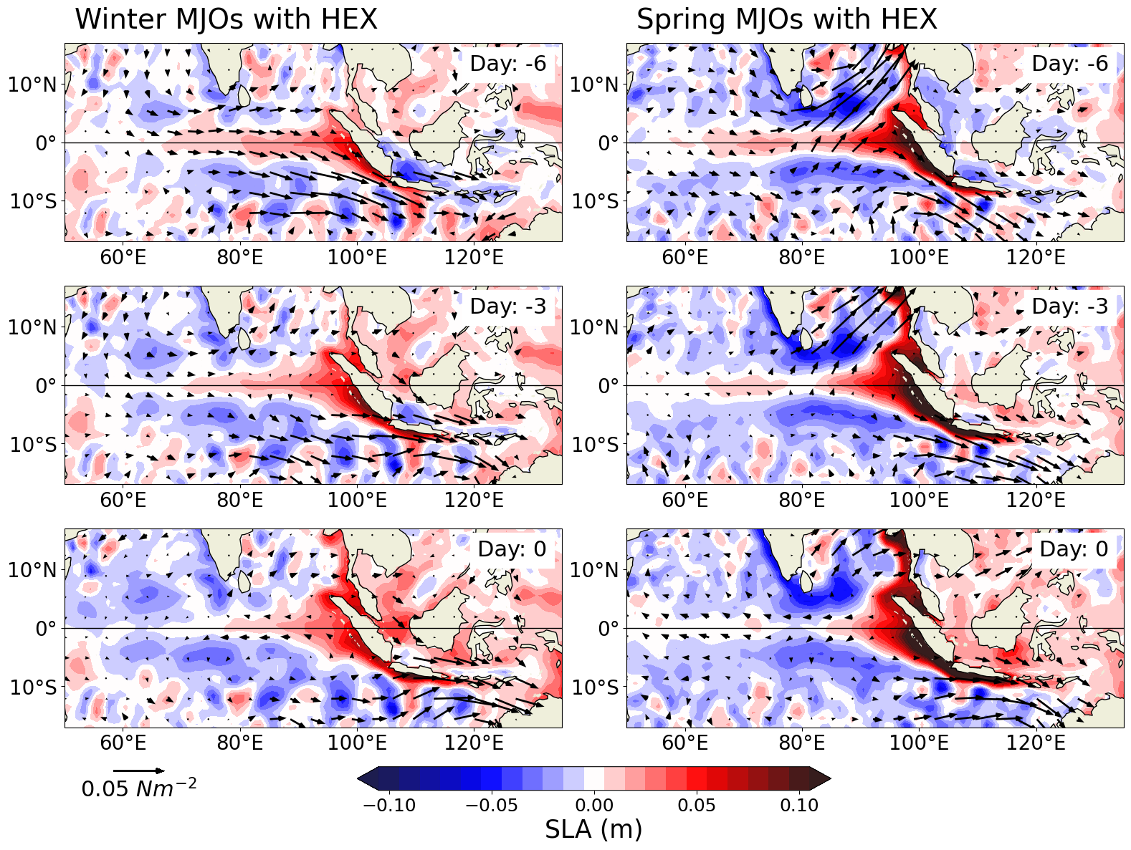
Seasonality of MJOs related to HEX
Spring MJOs have greater OLRA (convection) over the equatorial Indian Ocean
Spring MJOs produce greater westerly wind stress over the equatorial Indian Ocean
Spring MJOs have greater SLAs along the southern coast of Java

Slide 16
Summary:
The MJO forces Java SLAs during High EXtreme (HEX) sea level events primarily via westerly wind over the equatorial Indian Ocean
The MJO has the greatest impact on HEX during spring when convection and westerly wind anomalies peak over the equatorial Indian Ocean
Contact: William.Kamp@colorado.edu

